Slide 1
DIGITAL AUDIO EQUALIZER
Vishwakarma Institute of Technology, Pune-37
Department of Electronics and Telecommunications Engineering
Presented by,
Devarmani Rishikesh Surseh (K-73)
Jogi Shubhamkumar Sudhir (K-74)
Belwadi Faisal Ahmed (K-78)
Guided by,
Prof. M. S. Deshpande

Slide 2
Overview
Abstract
Literature Survey
Objectives
Project Specifications
Methodology
GUI View
Results
Applications
Conclusion
References

Slide 3
Abstract
One of the most used methods in digital signal processing is audio equalization. Equalizers are utilized in telecommunication systems, recording studios, acoustics, and many devices such as microphones and speakers. The purpose of developing an equalizer is to limit the factors that have a negative impact on the quality of an audio signal, which can be accomplished by boosting the parts of the signal. MATLAB provides a range of tools that are applicable to audio equalization. MATLAB’s Butterworth function is used in order to design filters for this equalizer.

Slide 4
Literature Survey
Implementation of a Multi-band Equalizer in MATLAB and Simulink Using Algorithm Manipulation, Roger Williams University:
Audio equalizers can be used to manipulate signal frequencies to improve sound quality for different listening environments. The results show an audio equalization algorithm that was verified by analyzing test signals to compare frequency response before and after equalization.
Building an Equalizer, EE 262, Lab Section A2, Department of Electrical Engineering, University of Missouri-Rolla:
Equalization is a signal processing technique that cancels out distortions caused by noise sources and imperfections in mediums. This paper describes the procedure and results of simulating an equalizer using MATLAB. The methods for determining frequency response of a sound are also discussed.

Slide 5
Objectives
The main objective of designing the digital audio equalizer is to enhance the quality of the audio signal by boosting or attenuating the signal at the specific frequency.
Equalizing filters cancel out any phase delay between different frequency components.
The project also aims to cancel out the distortions due to imperfections in the speaker or due to poor acoustic features of a room, which can greatly improve output of audio systems.

Slide 6
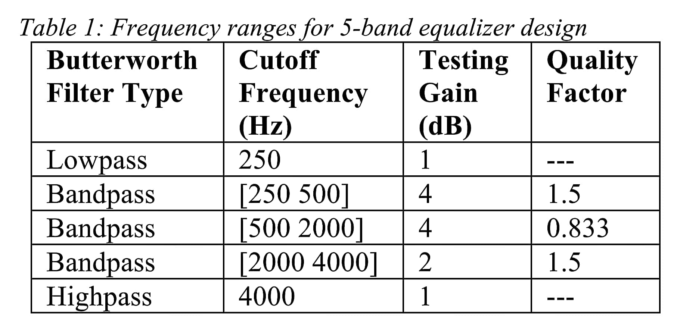
Project Specifications

Slide 7
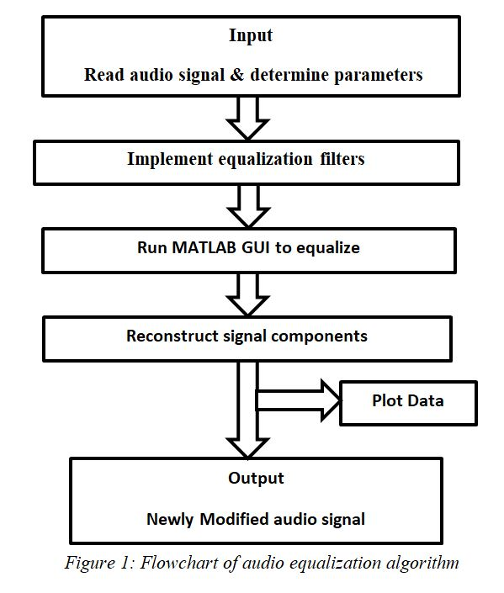
Methodology

Slide 8
In the design process, the FIR filters were implemented in a way to create the proposed multi-band filtering algorithm. These discrete Finite Impulse Response filters (FIR) obtain the coefficients from the Butterworth transfer function to equalize a test signal.
Implementing Filters
h2=fir1(100,2*250/Fs,'lowpass');
h3=fir1(100,[2*250/Fs 2*500/Fs],'bandpass');
h4=fir1(100,[2*500/Fs 2*2000/Fs],'bandpass');
h5=fir1(100,[2*2000/Fs 2*4000/Fs],'bandpass');
h6=fir1(100,[2*4000/Fs 2*20000/Fs],‘highpass');
Plot the original and the filtered signal using FFT.

Slide 9
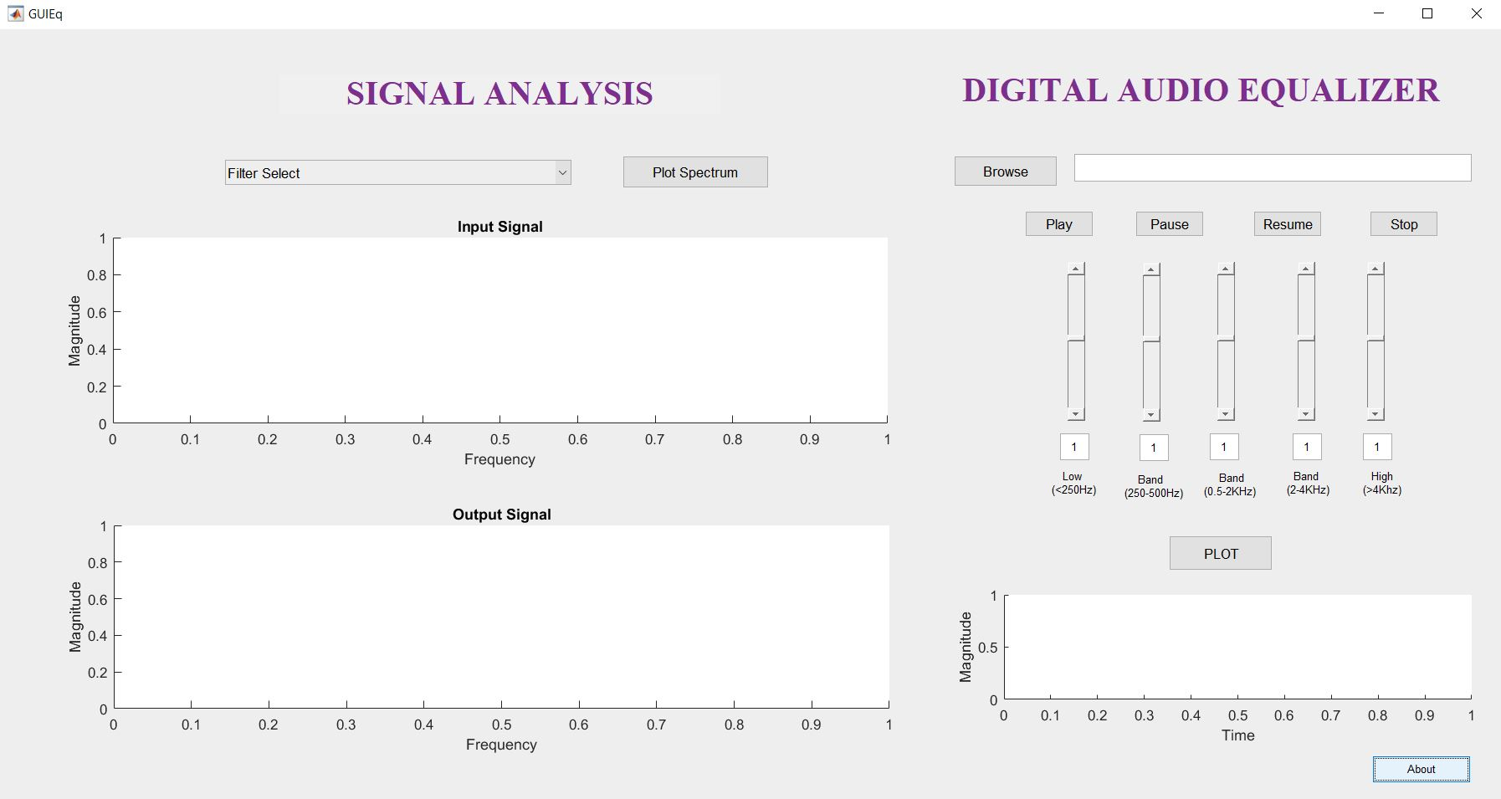
GUI View

Slide 10
Results
The browse button allows to access any audio file to play. The other buttons such as play, pause, resume and stop perform the operations of start, pause , continue and stop playing the audio signal.
The five sliders representing the five frequency bands are used to adjust the gain of the specific frequency band i.e. boosting and attenuation of the signal at the desired frequency.
The analysis of the filtered audio signals is performed using the Fast Fourier Transform(FFT).

Slide 11
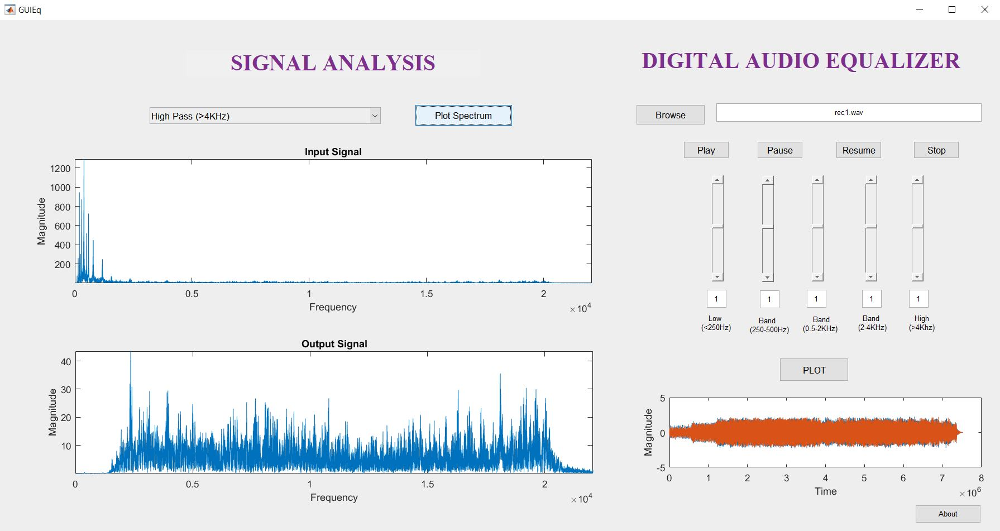

Slide 12
Applications
Telecommunication Systems
Microphones and speakers
Acoustics
Recording Studios
Stereo System

Slide 13
Conclusion
The quality of the signals was verified by visual comparisons of the frequency response and spectrograms, as well as by comparing audio outputs.
The change in the gain of the frequency band with the help of the sliders provided a desired quality of the signal.
The performance of the equalizer is tested better in terms of noise cancellation also.

Slide 14
References
[1] Building an Equalizer, EE 262, Lab Section A2, Department of Electrical Engineering, University of Missouri-Rolla.
[2] Implementation of a Multi-band Equalizer in MATLAB and Simulink Using Algorithm Manipulation, Roger Williams University.
[3] MathWorks Documentation

Slide 15
THANK YOU

